Slide 1
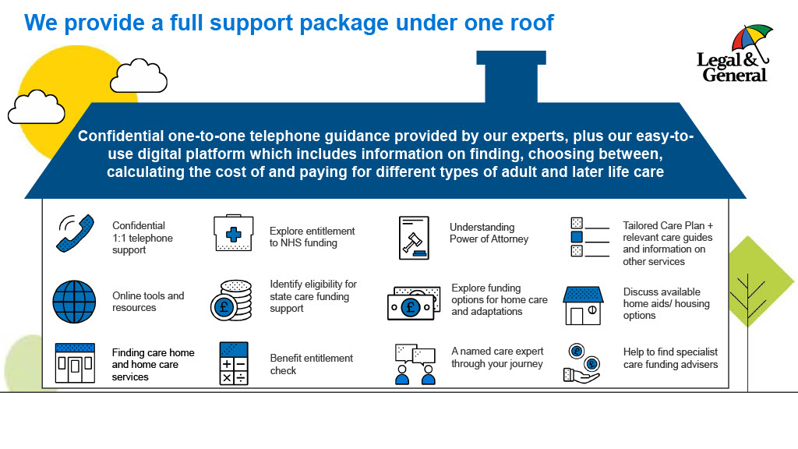
What is Care Concierge?
Get In Touch with Care Concierge
Care Concierge is a confidential telephone guidance service which allows you to speak directly to an expert about adult and later life care.
Open to all employees
Completely free of charge
100% Confidential
No cap or limits on usage
Support and guidance for those requiring adult or later life care (aged 18 or over) in the UK (England, Wales, Scotland, Northern Ireland)
To speak with us about any Care related needs, call on: 0800 060 8823*
Monday to Friday 9am – 5pm
*All calls to this number are free. Please note, calls may be
Recorded and monitored. Your personal data will be treated in
line with Data Protection legislation and our Privacy Policy which
can be found at: legalandgeneral.com/privacy-policy
Or visit their website 24/7:
care.legalandgeneral.com/group-protection
Notes:
Putting care provision in place for a loved one can be a daunting and confusing experience, that could cause significant disruption in your life. Our service can help.
Care Concierge is a confidential telephone guidance service which allows you to speak directly to an expert about finding care for a loved one.
You can access as much help as you need and be supported to find the right care, regardless of what type.
There can be big questions to answer when going through the process of finding care. They could include:
What is a Power of Attorney and how do I set one up?
What type of care is available for my loved one, and how do I find it?
Are benefits available to me?
What questions should I be asking care providers?
How do I access support from my local authority and what help is available?
How much does care cost and who pays for it?

