Slide 1
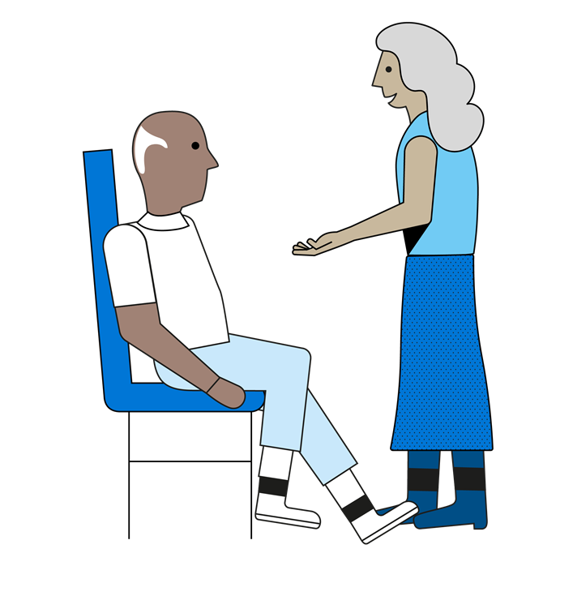
Am I a Carer?
A carer is anyone who cares, unpaid, for a friend or family member who due to illness, disability, a mental health problem or an addiction cannot cope without their support.
If you are not sure if this applies to you, this 2 minute video could help:
Recognising if you are a Carer is the first step to getting the support you need

