Slide 1

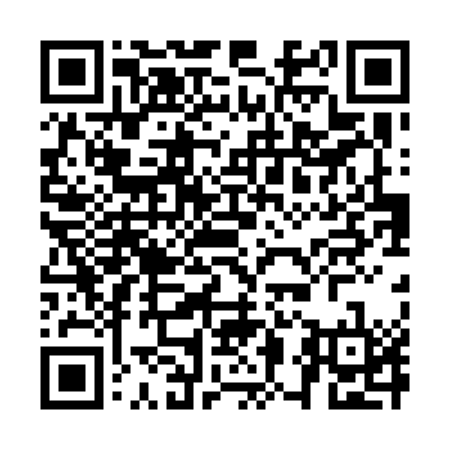
Emotional support for carers
When so much of your time and energy is focused on another person, it is easy to put your own feelings to one side. Yet looking after your emotional wellbeing can help you better manage and continue caring.
Our video exploring emotional support for carers offers a look at the pressures and challenges caring can bring and the support that may help.
You can access it here: Emotional support for carers
Alternatively scan
this QR code:

