Slide 1

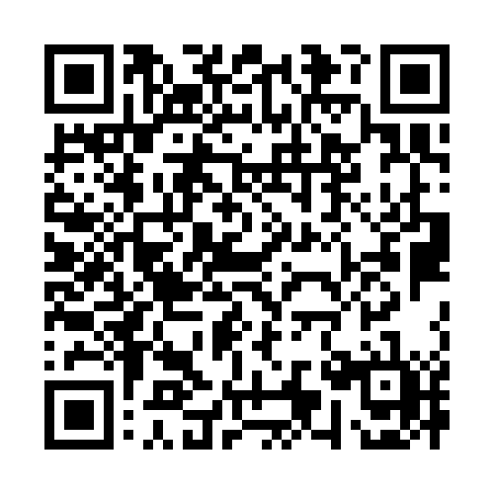
Understanding Powers of Attorney
A power of attorney can help ensure that someone you trust is able to make important decisions on your behalf if you are ever unable to do so yourself. Yet many people put it off because the process can feel complicated or believe it is only something to consider later in life.
This video will help you understand what a power of attorney is, how it works and why putting one in place can give you and those close to you, valuable reassurance.
You can access it here: Understanding Powers of Attorney
Alternatively scan
this QR code:

