Slide 1

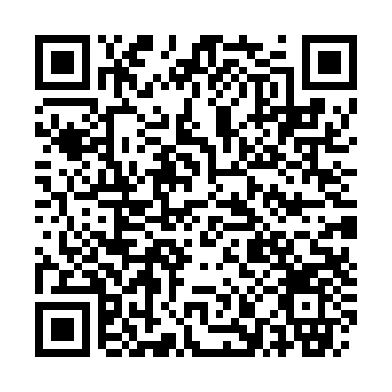
Preventing falls and living safely
Falls can happen to anyone, but small, practical changes can make a real difference. Knowing how to spot potential risks and build safer habits can help you or someone you care about feel more confident and independent at home and when out and about.
Watch this video for simple tips on preventing falls and creating a safer living environment. This should help you take positive steps to reduce risks, stay active and continue living well with greater peace of mind.
You can access it here: Preventing falls and living safely
Alternatively scan
this QR code:

