Slide 1

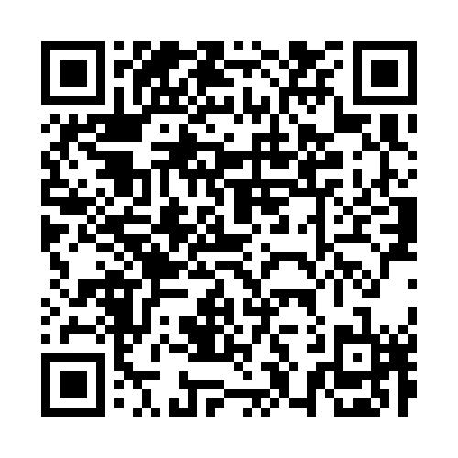
Are you supporting adult loved ones?
Caring for someone can be rewarding, but it can also feel demanding, isolating and overwhelming at times. Knowing what support is available to you as a carer can help you manage everyday challenges, feel more confident in your caring role and remember that you do not have to cope alone.
This video explores practical guidance, useful resources and various sources of financial and wellbeing support for carers.
You can access it here: Support For Carers Video | L&G
Alternatively scan
this QR code:

