Slide 1

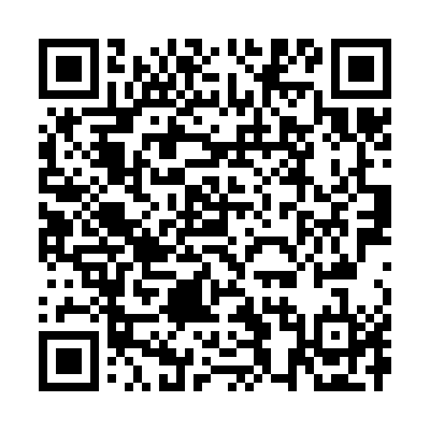
Caring for someone with Dementia?
Caring for someone with dementia can feel overwhelming and unpredictable. Understanding how dementia may affect a person’s memory, communication and behaviour can help you respond with greater confidence, patience and compassion.
This video offers practical guidance to help make everyday situations a little easier for you and the person you care for.
You can access it here: Caring for someone with Dementia
Alternatively scan
this QR code:

