Slide 1

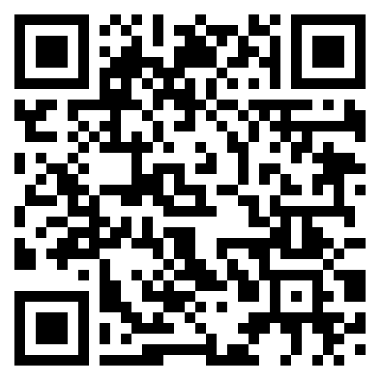
Get in touch
To speak with them about any adult care related needs, call on:
0808 189 3195*
Monday to Friday 9am – 5pm
Open to all colleagues and family members
Free of charge
100% confidential
No limits on usage
Support and guidance for those requiring adult care in the UK
Visit their website:
https://care.legalandgeneral.com/workplace

