Slide 1
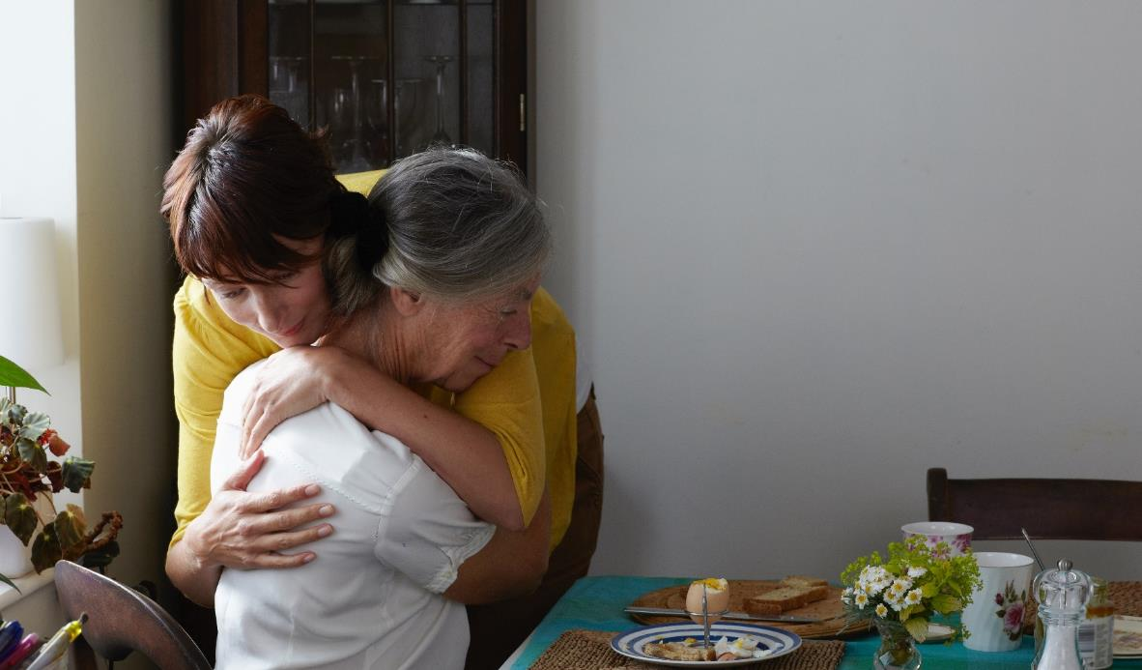

Supporting you through the adult and later life care journeys with Care Concierge

Slide 2

Am I a Carer?
A carer is anyone who cares, unpaid, for a friend or family member who due to illness, disability, a mental health problem or an addiction cannot cope without their support.
When we think about a carer we often think about providing ‘personal care’ such as bathing or dressing. However, there are many different ways to support someone, such as:
Picking up shopping
Help with cleaning
Accompanying a loved one to appointments
Collecting prescriptions
Making up the bed
Providing emotional support

Slide 3
What is Care Concierge?
Care Concierge provides confidential telephone guidance which allows you to speak directly to an expert about finding care for a loved one.
You can access as much help as you need and be supported to find the right care, regardless of what type.
Care Concierge is:
Open to everyone
Completely free of charge
100% Confidential
Unlimited with no restrictions on usage
Support and guidance for those navigating an adult or later life care journey in the UK

Slide 4















We provide a full support package under one roof
Confidential one-to-one telephone care concierge resource provided by our experts, plus our easy to use website which includes guidance on finding, choosing between, calculating the cost of and paying for different types of adult and later life care
Confidential 1:1 telephone support
Explore entitlement to NHS funding
Understanding Power of Attorney
Tailored Care Plan + relevant care guides and information on other services
Identify eligibility for state care funding support
Explore funding options for home care and adaptations
Discuss available home aids/ housing options
Online tools and resources
Finding care home and home care services
Benefit entitlement check
A named care expert through your journey
Help to find specialist care funding advisers

Slide 5


How to access Care Concierge
You can call 0800 060 8823 between 9am – 5pm, Mon - Fri
You’ll be able to speak to one of our experienced care experts for emotional and practical support
You will receive expert guidance through a range of topics based on your personal circumstances
A tailored care plan will be created to enable you to navigate your way through care smoothly, with reminders documented on what steps to take
Our friendly care experts are available for as long as you need them, whether it’s for continued support throughout the care plan or just a friendly check in point. Useful information is also available on our website below
Or visit our website: care.legalandgeneral.com/group-protection/

Slide 6
Thank You
Legal & General Partnership Services Limited is a wholly owned subsidiary of Legal & General Group plc. Registered in England and Wales number 05045000. Registered office: One Coleman Street, London, EC2R 5AA, United Kingdom

