Slide 1

Caring for those
with Dementia

Slide 2
Contents
What is Dementia?
Common types of Dementia and their symptoms
How to talk to loved ones about Dementia
Caring for someone with Dementia – What you can do to help
Care for the Carer – How to stay fit and healthy whilst Caring

Slide 3
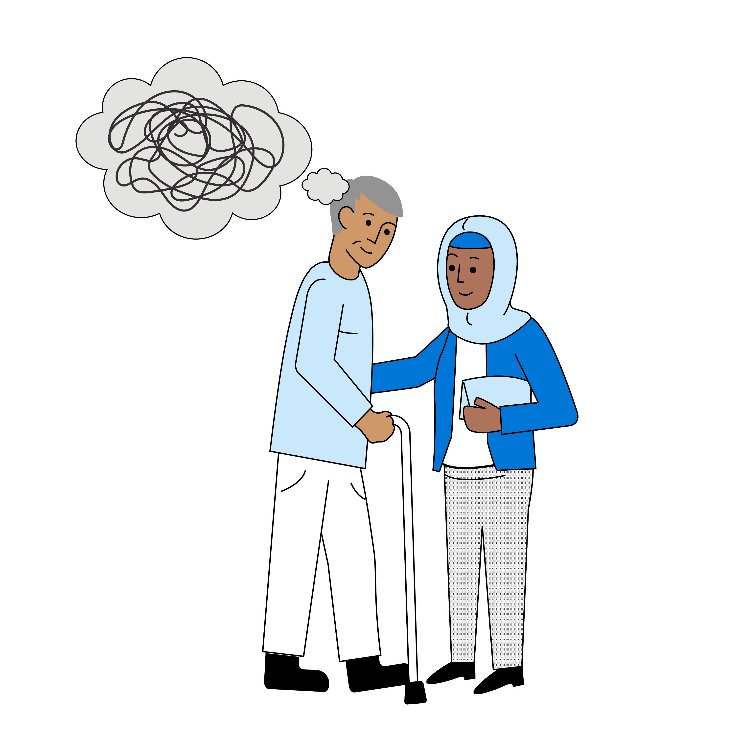
What is Dementia?
Dementia is an umbrella term for a range of progressive conditions that affect the brain.
Each type of Dementia stops the brain cells from working normally.
By 2025, it’s estimated that over one million people in the UK will have a diagnosis of Dementia – and almost all of us will know someone living with the condition.
Dementia can affect a person at any age.
There are over 200 subtypes of Dementia, all of which have different symptoms and can affect a person in different ways.
The most common forms of Dementia are Alzheimer’s disease, Vascular Dementia, Lewy Body Dementia, Frontotemporal Dementia and Mixed Dementia.
Notes:
Types of dementia | Alzheimer's Society (alzheimers.org.uk)

Slide 4
Common types of Dementia and their symptoms
Alzheimer's Disease
Alzheimer’s disease is the most common form of Dementia in the UK
It is also the most common form of Dementia in younger people
Changes in the brain can occur up to ten years before a person starts to show symptoms of Alzheimer’s disease
Symptoms are usually mild to begin with and deteriorate over time
The most common symptoms include:
difficulty remembering recent events or conversations, while having a good recollection of historical milestones and interactions
confusion and disorientation
loss of interest in activities they used to enjoy
slow, muddled or repetitive speech
withdrawal from family and friends
mood swings, anxiety and depression
Notes:
Alzheimer’s disease is the most common form of dementia, around 60% of diagnoses in the UK, and is the most common form of young onset dementia, accounting for around a third of younger people with dementia.
A small number of people have an inherited form called Familial Alzheimer’s disease (FAD) which is caused by a faulty gene that runs within families. People with FAD typically first develop symptoms before the age of 65, most commonly in their 40s or 50s.
People with Down’s syndrome and other learning disabilities can also develop Dementia at an early age. If people with Down’s syndrome develop dementia, it is usually Alzheimer’s disease.
The exact cause of Alzheimers is unknown but we do know it occurs when an abnormal protein surrounds brain cells and the chemical connections between brain cells are lost. As a result, cells begin to die, affecting day to day memory and causing the person to experience difficulty finding the right words or solving simple problems.
People diagnosed with Alzheimer’s may also see a reduction of a chemical called acetylcholine. This serves as a chemical ‘messenger’ to take information to and from brain cells, so when this happens it leads to information not being transmitted effectively throughout the brain.
Research has told us that changes in the brain can occur up to ten years before a person starts to show symptoms of Alzheimer’s disease. The symptoms are usually mild at the beginning and gradually worsen over time.
difficulty remembering recent events or conversations, while having a good recollection of historical milestones and interactions
poor concentration levels, becoming easily distracted
difficulty recognising loved ones or everyday objects
restlessness, fidgeting
confusion and disorientation, getting lost in familiar places
loss of interest in activities they used to enjoy
slow, muddled or repetitive speech
withdrawal from family and friends, forgetting names, changes in social behaviour
mood swings, anxiety and depression
difficulty making simple decisions or performing simple tasks
There is currently no cure for Alzheimer’s disease, there are some medications that may help with some of the symptoms and make life a little easier. These medications may also slow the progression of Alzheimer’s disease for a short while in some people, but it does not prevent or cure the condition.
Types of dementia | Alzheimer's Society (alzheimers.org.uk)

Slide 5
Common types of Dementia and their symptoms
Vascular Dementia
Vascular dementia is the second most common type of dementia after Alzheimer’s disease.
It is caused by problems with the blood supply to the brain
Vascular dementia is most common in people aged over 65, and the risk increases as people grow older.
Vascular dementia is slightly more common in men
Other factors that increase the chance of developing vascular dementia are, high blood pressure, smoking, obesity, physical inactivity and traumatic brain injury.
The symptoms of vascular dementia depend on which area of the brain has been affected (usually by a stroke)
The main symptoms are:
  difficulty with language and speaking
  difficulty reading, writing and communicating
If the area of the brain that is responsible for memory has not been damaged, memory problems may not be an issue initially, although they may develop later on.
Notes:
Vascular dementia is the second most common type of dementia after Alzheimer’s disease.
It is caused by problems in the blood supply to the brain due to damaged or diseased blood vessels,, essentially a stroke, or ‘mini strokes’ called transient ischaemic attacks (TIAs).
This deprives the brain cells of the oxygen and nutrients they need to function effectively, which may cause problems with concentration, thinking and carrying out everyday activities.
Vascular dementia is most common in people aged over 65, and the risk increases as people grow older. However, it can also occur in younger people, and is the second most common form of young onset dementia (where symptoms develop before the age of 65).
Vascular dementia is slightly more common in men and people with a family history of vascular dementia may also be at slightly greater risk.
Other factors that increase the chance of developing vascular dementia are:
high blood pressure
smoking
obesity
depression
physical inactivity
excessive alcohol consumption
traumatic brain injury
high air pollution
second-hand tobacco smoke
However, vascular dementia may be mistaken for other conditions, such as depression, stress, relationship problems, menopause and work-related issues. This can cause a delay in diagnosis.
Currently, there are no specific treatments for vascular dementia, but medication may be given for underlying conditions such as high blood pressure, high cholesterol, heart problems or diabetes.
Medications for Alzheimer’s disease are not effective for vascular dementia, unless the person has been diagnosed with mixed dementia.
A person with vascular dementia should be supported to stop smoking, exercise, regularly, eat a healthy diet and maintain a healthy weight. These steps won’t cure vascular dementia, but it may slow its progression.
Types of dementia | Alzheimer's Society (alzheimers.org.uk)

Slide 6
Common types of Dementia and their symptoms
Lewy Body Dementia
Progressive and complex form of Dementia accounting for approximately 10-15% of all those diagnosed with Dementia.
It is caused by abnormal clumps of protein gathering inside brain cells.
Memory is normally less affected, instead it cause mood and behaviour changes, anxiety, depression delusions, hallucinations and paranoia.
The symptoms of Lewy Bodies include:
  Visual hallucinations
  Disturbed sleep
  Slow movement and balance issues
  Bladder and bowel problems
  Mood swings and behavioural changes
  Fluctuating alertness
Notes:
Lewy body dementia is a progressive, complex and challenging condition, which accounts for around 10 - 15% of all those diagnosed with dementia. Around 10% of younger people with dementia have dementia with Lewy bodies.
In the early stages it is often mistaken for Alzheimer’s disease and can be diagnosed incorrectly.
It particularly affects the person’s ability to think and move and can cause hallucinations, fluctuations in alertness and sleep disturbances, which can be extremely distressing for the person and their family.
Lewy body dementia is caused by abnormal clumps of protein (called Lewy bodies) gathering inside brain cells. These Lewy bodies can build up in many parts of the brain but particularly in the areas responsible for thought, movement, visual perception and regulating sleep and alertness.
Memory is often less affected than with other types of dementia but people may be at more risk of mood and behaviour changes such as anxiety, depression, delusions and paranoia. One type of delusion, known as CAPGRAS syndrome, in which the person believes that a friend or relation has been replaced by an imposter can be particularly difficult for families.
recurring visual hallucinations (seeing things that are not there – these can be pleasant or upsetting)
disturbed sleep, known as Rapid Eye Movement (REM) sleep disorder, with restlessness and intense dreams/nightmares
sudden changes and fluctuations in alertness – people may stare blankly into space, seem drowsy and lethargic and spend a lot of time sleeping
slow movement, difficulty walking, shuffling, or appearing rigid
tremors – usually in the hands while at rest
problems with balance, leading to falls
bladder and bowel problems
difficulties with swallowing
mood and behaviour changes such anxiety and depression
delusions and paranoia
It can also alter blood pressure levels, body temperature and cause an impaired sense of smell.
People with Lewy body dementia may be offered medication and other interventions to help with their symptoms. These will not stop or reverse the course of the disease, nor cure it, but can improve the quality of life. Some of the medications used to treat Alzheimer’s disease can help with the cognitive symptoms of Lewy body dementia and can help reduce distressing but these are usually most effective in early or moderate phases.
Other interventions focus on symptom control and include; physiotherapy, occupational therapy, counselling, and cognitive stimulation therapy, such as games, music and activities.
Types of dementia | Alzheimer's Society (alzheimers.org.uk)

Slide 7
Common types of Dementia and their symptoms
Frontotemporal Dementia
An umbrella term for a group of dementias that mainly affect the frontal and temporal lobes of the brain.
Although it falls into one of the most common types, it is rather rare representing only 5% of all people with a Dementia diagnosis.
It is caused by abnormal build-up of proteins in the frontal and temporal lobes of brain, which damage the brain cells.
Most commonly affects people aged 40-60
The symptoms of Frontotemporal Dementia include:
  Lack of motivation
  Inappropriate behaviour
  Lack of focus
  Obsessive and repetitive behaviour
  Changes in relationships with food
Notes:
Frontotemporal dementia (FTD) is an umbrella term for a group of dementias that mainly affect the frontal and temporal lobes of the brain, which are responsible for personality, behaviour, language and speech.
Unlike other types of dementia, memory loss and concentration problems are less common in the early stages.
FTD is a rare form of dementia affecting around one in 20 people with a dementia diagnosis.
In FTD, there is an abnormal build-up of proteins within the brain, which damages the cells. Due to the this, it affects personality, behaviour and speech. Often sufferers can forget the meaning of words and become very upset and frustrated.
FTD is most common in people aged 40 to 60 but can also affect younger or older people.
reduced motivation
lack of interest in things the person used to enjoy
inappropriate behaviour, eg making suggestive comments, staring, being over-familiar with people
reduced empathy
difficulty focusing on tasks
obsessive or repetitive behaviour, eg repeating phrases or gestures, hoarding
changes in behaviour regarding food or drink, eg craving sweet foods, poor table manners, overeating, drinking too much alcohol
difficulty with planning, organising and decision-making
There is no known prevention or cure for FTD. In some cases, medication may be prescribed, but this is not always suitable.
Types of dementia | Alzheimer's Society (alzheimers.org.uk)

Slide 8

Common types of Dementia and their symptoms
Mixed Dementia
Mixed Dementia is a term used to describe
brain changes which cause more than one type of Dementia.
Symptoms will depend on the types of Dementia present.
Notes:
Types of dementia | Alzheimer's Society (alzheimers.org.uk)

Slide 9
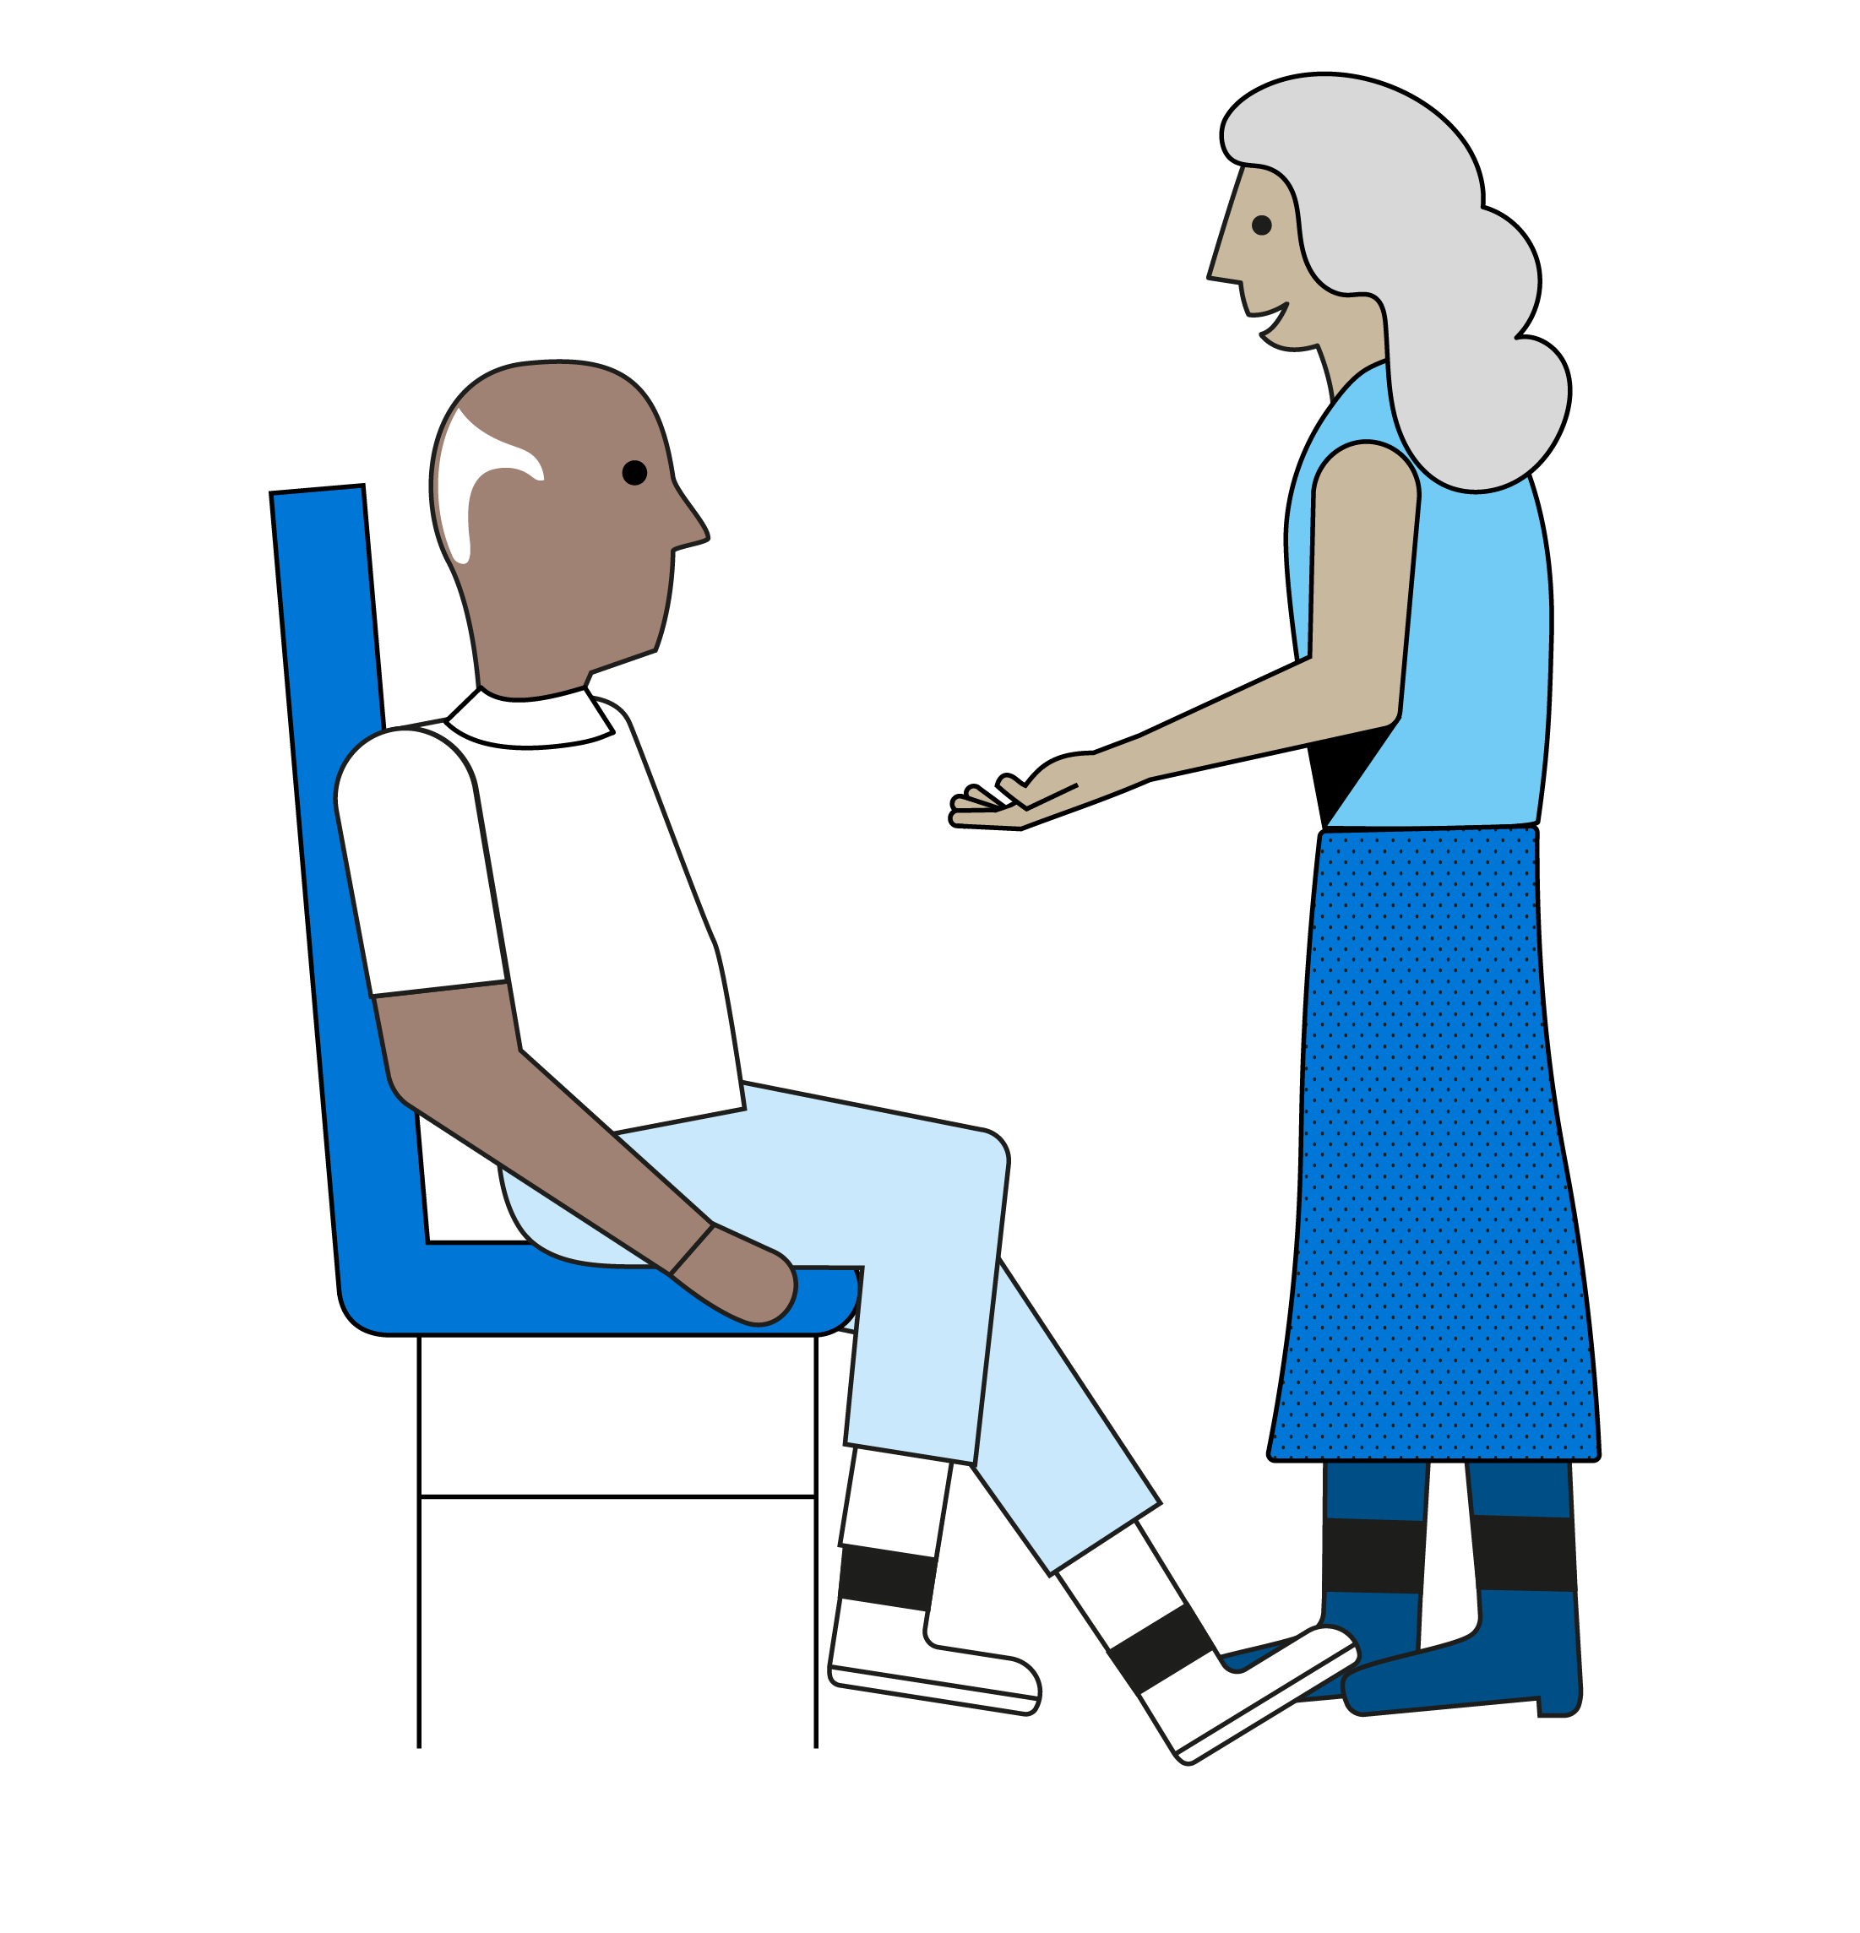
How to talk to loved ones about Dementia
If someone you know is having problems with their memory, talking about it can help them get support.
If these problems are affecting their everyday life, you should encourage them to see a GP.
Before starting a conversation with someone you're concerned about, the Alzheimer's Society suggests you ask yourself:
What could be stopping the person from seeing their GP?
Have they mentioned their memory problems?
Do they describe their memory problems as a natural part of ageing?
Could they be scared about what the changes could mean?
Do they think there won’t be any point in seeking help?
Would they find it reassuring to have someone offer to go to the GP with them?
Notes:
If someone you know is having problems with their memory, talking about it can help them get support. If these problems are affecting their everyday life, you should encourage them to see a GP.
Before starting a conversation with someone you're concerned about, the Alzheimer's Society suggests you ask yourself:
What could be stopping the person from seeing their GP?
Have they mentioned their memory problems?
Do they describe their memory problems as a natural part of ageing?
Could they be scared about what the changes could mean?
Do they think there won’t be any point in seeking help?
Would they find it reassuring to have someone offer to go to the GP with them?
There isn't a 'right' or 'wrong' way to discuss what you’ve noticed. It's a good idea to think about the person, your relationship, and how they prefer to communicate.
The following tips may also help;
Pick a place that is familiar and non-threatening, so you can talk about it where you both feel comfortable.
Find a quiet time when you won’t be rushed, disturbed or interrupted. If this is when the GP surgery is open and the person feels ready to book a GP appointment, they can do this.
Choose the words you use carefully – use reassuring and non-judgemental language.
You might start the conversation by gently asking the person if they’ve noticed any changes about themselves recently or been feeling any different from usual. Are they struggling with anything?
If appropriate, mention things you’ve noticed or examples that you’re concerned about. Show that you are raising concerns because you care about them and want to offer support.
Be positive – if their problems are due to an illness such as dementia, talking to a GP can lead to the help and support they need. Listen to the person and take on board how they respond. They may not react how you expect them to. You may need to adapt your approach, but try not to worry if they don’t respond well. This may come as a surprise to them and make them frightened and confused. Or they may not be aware of the problems you’ve noticed.
If the person does not want to see a GP, many UK dementia charities offer support and advice from specialist nurses or advisers, such as:
Dementia UK helpline: 0800 888 6678 or email: helpline@dementiauk.org
Alzheimer's Society's national helpline: 0333 150 3456 or email: helpline@alzheimers.org.uk
Talking to someone about their memory problems | Alzheimer's Society (alzheimers.org.uk)

Slide 10
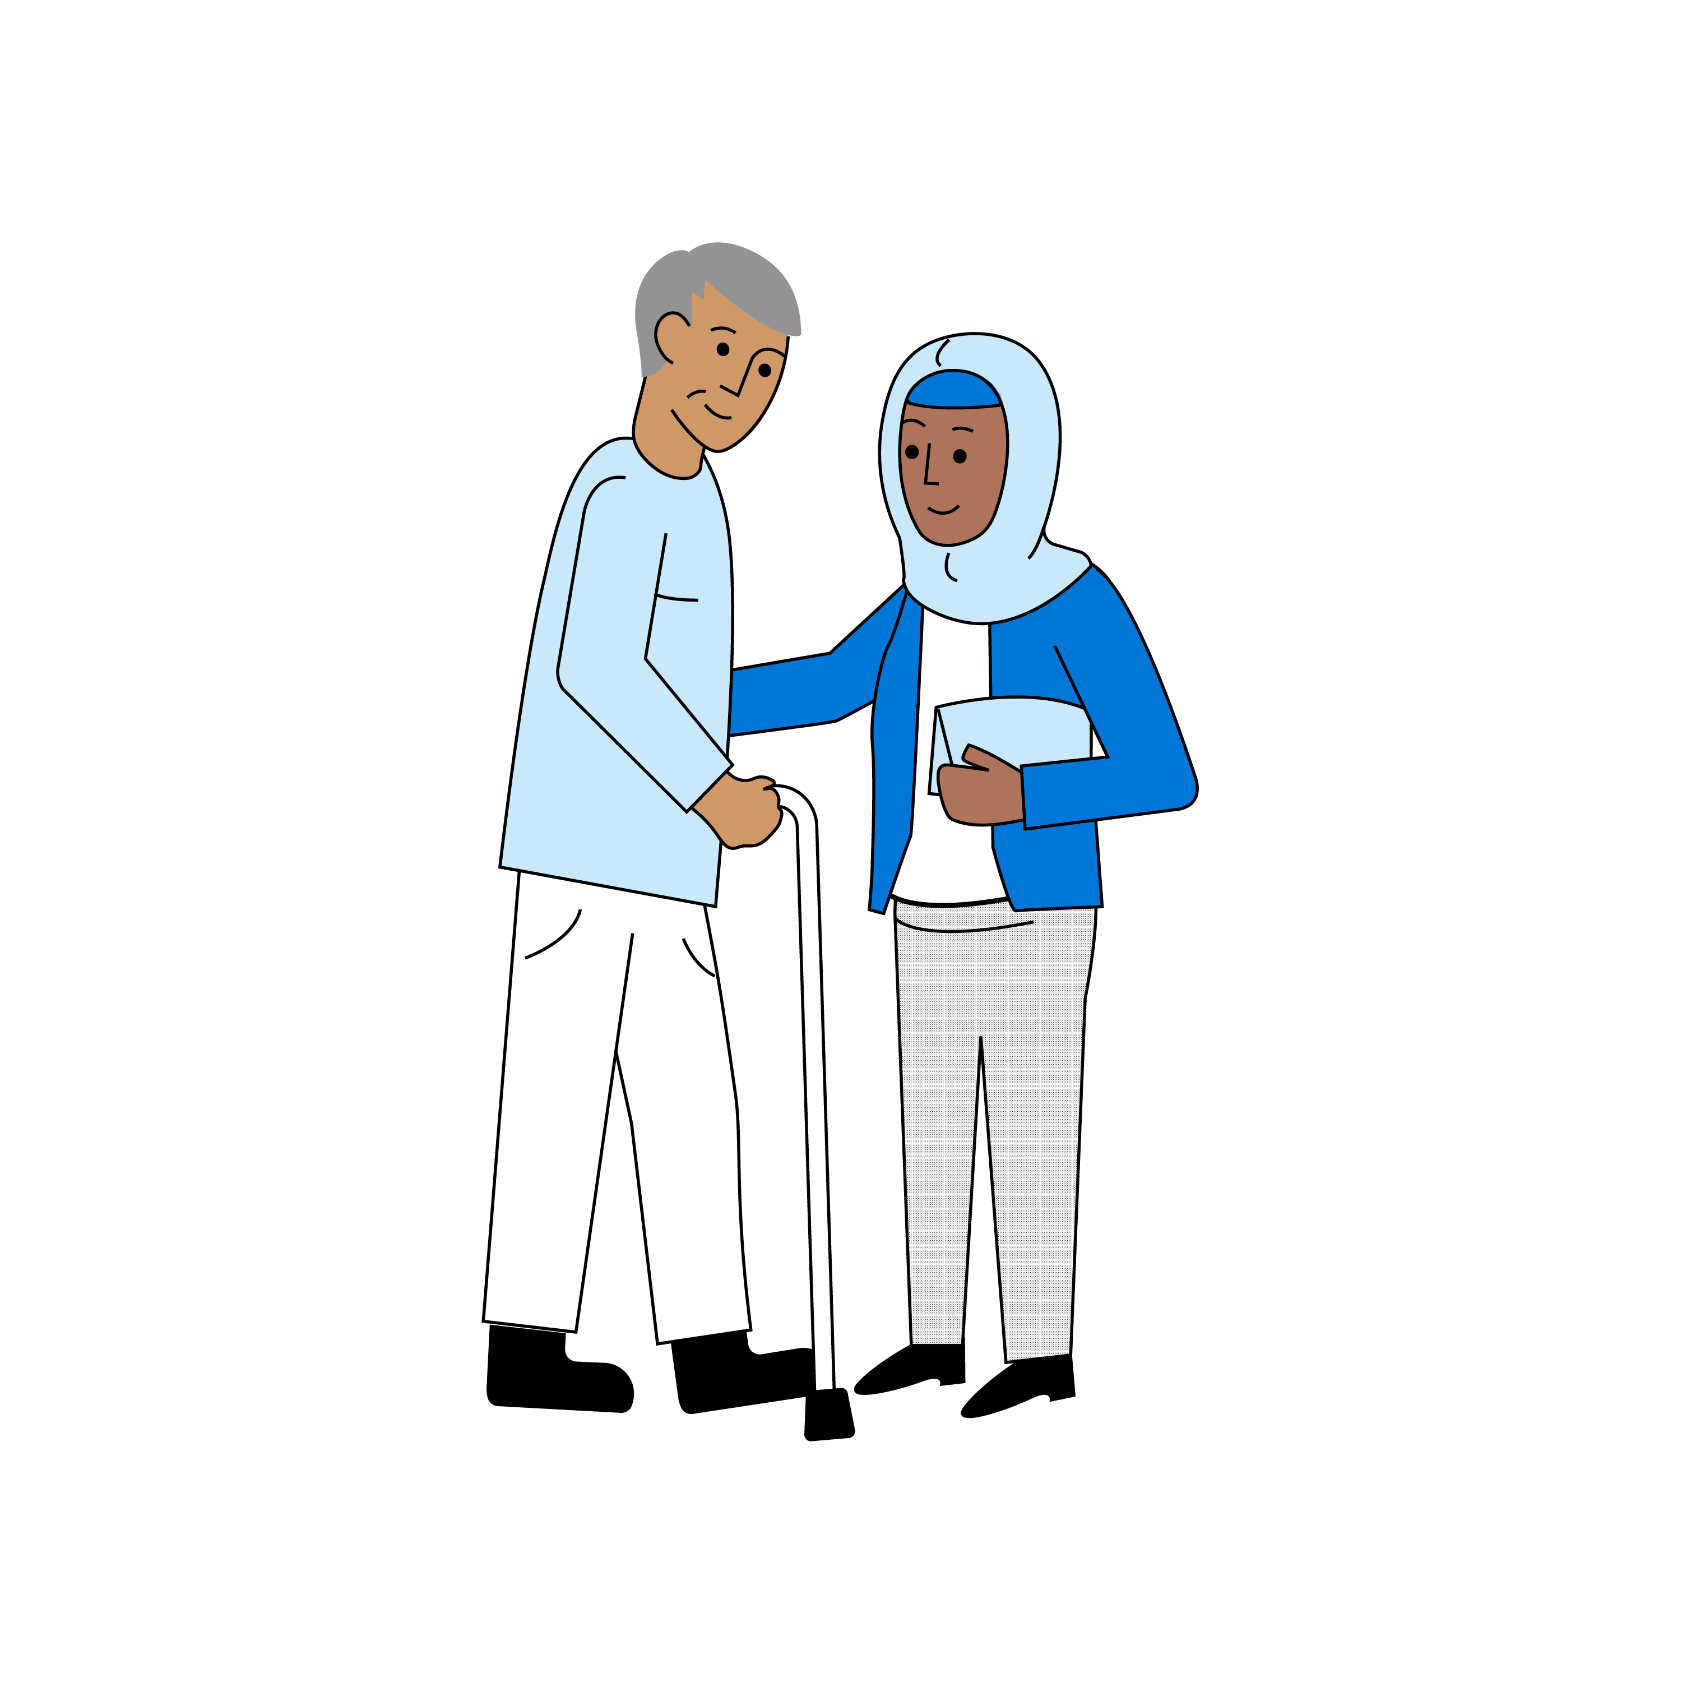
Caring for someone living with Dementia
Communication Problems
Difficulty pronouncing or finding the right words
Losing track of what they are saying
Asking for things or remembering things that are no longer there or cannot be done anymore
Being withdrawn, angry or upset
Not able to understand what you are saying
Notes:
Dementia is a complex condition and every person’s experience is different. However, many people living with dementia can face similar challenges with communication. Often the small changes we make in our approach can make a big difference in avoiding communication difficulties or frustration.
Communication challenges may include:
Difficulty pronouncing or finding the right words
It is important to try not to finish their sentences as this can cause embarrassment and make them upset or frustrated with themselves. Instead repeat back to them what they have said and this can help them reattach their thread of speech. If it is clear they are struggling with particular words, and you know what they are trying to say, ask them if they “mean” this, rather than finishing the word for them.
Losing track of what they are saying
Listen with attention, so if they forget what they were saying you can help them to recall what they were telling you about. Repeat back to them what they have said, and if it doesn’t come back to them then that’s fine, reassure them they can tell you another time.
Asking for things or remembering things that are no longer there, cannot be done anymore or they already have
For example: The person living with dementia keeps asking for their mum or dad. For many people, parents mean comfort/security/love. The person might be trying to experience these feelings again. Ask the person living with dementia what their parents are/were like, and what things they like/liked doing together.
They keep talking about needing to go to work even though they are no longer working. They may need to feel a sense of purpose; that they are useful and needed. Encourage them to take part in activities that might interest or mean something to them, such as household or garden tasks or helping you sort out paperwork.
They are asking to go home when they are at home. They might be missing a sense of safety, security or familiarity, or remembering something that they used to do. Reassure them by having a look at some familiar things eg, old photos, videos, or items around the home. Ask them about their ‘home’ and what it is like.
Being withdrawn, angry or upset
This could be down to an inability to express themselves due to language problems, temporal lobe damage, or possible depression. This might also be due to loss of recognition of familiar people, faces and environment. It could be due to fear or memory changes.
They may also get more confused, restless and disorientated at certain times of the day as a symptom of medications. This could be the lead up to them becoming more distressed and upset. It’s helpful to notice these small changes in behaviour so you can intervene with activities and distraction techniques, which might stop their distress from escalating.
They are feeling sad or angry and can’t explain why. They could be in pain, not feeling well or something could be irritating them about their environment. Try validating their feelings eg, by saying, “You look sad about something” or, “what’s bothering you?” Check the room to see if the temperature and lighting is ok for them, check they are comfortable and if they are hungry, thirsty, hot or cold.
Not able to understand what you are saying
This could be due to a lower level of understanding, difficulty with concentrating, or too many distractions.
Be reassuring and gentle at all times and try saying or asking things in a different way. Give them time and reduce external distractions where possible, like turning off the radio or television. Make sure you have eye contact and speak slowly when talking to them, and keep information or questions clear, simple and to a minimum.
Use their name when talking to them and be specific by using other peoples names instead of he or she if telling a story about someone or something which is happening
We communicate a lot through our body language, facial expressions, and tone of voice. If we seem positive, cheerful and confident, we bring a sense of hope and reassurance to the conversation. If we seem agitated, cross or unhappy, we can also bring a sense of gloom into the environment.
Talking to someone about their memory problems | Alzheimer's Society (alzheimers.org.uk)

Slide 11

Caring for someone living with Dementia
Dealing with emotions
Anxiety
Depression
Apathy
Lack of purpose
Notes:
Anxiety is a feeling of fear or unease. It is a normal feeling for all of us, to an extent, but it can become so intense that it gets in the way of everyday life. People experiencing anxiety might feel like they are out of control, and experience physical symptoms including palpitations, sweating, headaches and panic attacks. Anxiety can affect sleep patterns.
A person with dementia experiencing anxiety may pace up and down, fidget or become agitated. They might follow a person they live with around the house, seeking reassurance, and may want to go to a place they feel safe.
Someone who becomes depressed may experience disturbed sleep, or sleep considerably more. They might become very withdrawn, stop eating or eat to excess, and may experience physical pain. The person may become ‘apathetic’, where they seem to retreat into themselves and lose interest in everyone and everything. Depression can cause tearfulness, poor concentration and make a person feel extremely fatigued.
As some of this behaviour described if often associated with dementia, anxiety and depression can sometimes be overlooked, and may need to be investigated and treated. Similarly, the early symptoms of dementia, for instance, poor concentration, sleep disturbance and changes in mood and behaviour mean Dementia can often be mistaken for Anxiety or Depression.
Anxiety and depression can affect anyone, at any time. Either can be brought on by physical health concerns, or big life changes such as the death or loss of a partner, but can also happen without there being a clear ‘reason’. People experiencing memory problems might become anxious or depressed because they are afraid of what is happening to them and worry about their family and their future.
Identifying anxiety and depression means the person with dementia can be treated and supported in the correct way. Untreated, these conditions can escalate.
So, how can we help to manage anxiety and depression? Well:
Help them engage with family members and friends and not be socially isolated, invite them out, perhaps visit for a picnic and dedicate time just for them
Encourage them to participate and get involved, give them a job or a purpose – this will help improve their willingness to be involved in everyday life
Make it clear to them that it is okay not to be okay, and ask what might make them feel better, or what is making them feel this way
Let them know you will try and help and they are supported and not alone
Alleviating anxiety and depression could:
• help improve appetite, ensuring good nutrition and improving the person’s overall health
• improve sleep quality so they feel well rested
• improve motivation, helping them take part in activities they enjoy, which in turn will help their general mood
It is not always possible for a person affected by anxiety or depression to recognise these symptoms in themselves. This can be even more difficult for someone who also has dementia, so it is important for family members and friends to make a note of changes in the person with dementia. If you suspect a person with dementia is experiencing anxiety and depression:
• Encourage them to go to the GP – especially if they are mentioning hopelessness or suicidal thoughts. It could be that medication such as anti-depressants might be required, to lift their mood and motivation, which might help them to engage in social activities and begin other types of psychological therapies e.g. counselling
• Support the person to practice self-help techniques. It doesn’t have to be anything fancy, it could be a simple as some gentle exercise, perhaps a walk outdoors, singing, dancing, art therapy or just listening to their favourite music
Anxiety and dementia | Alzheimer's Society (alzheimers.org.uk)

Slide 12
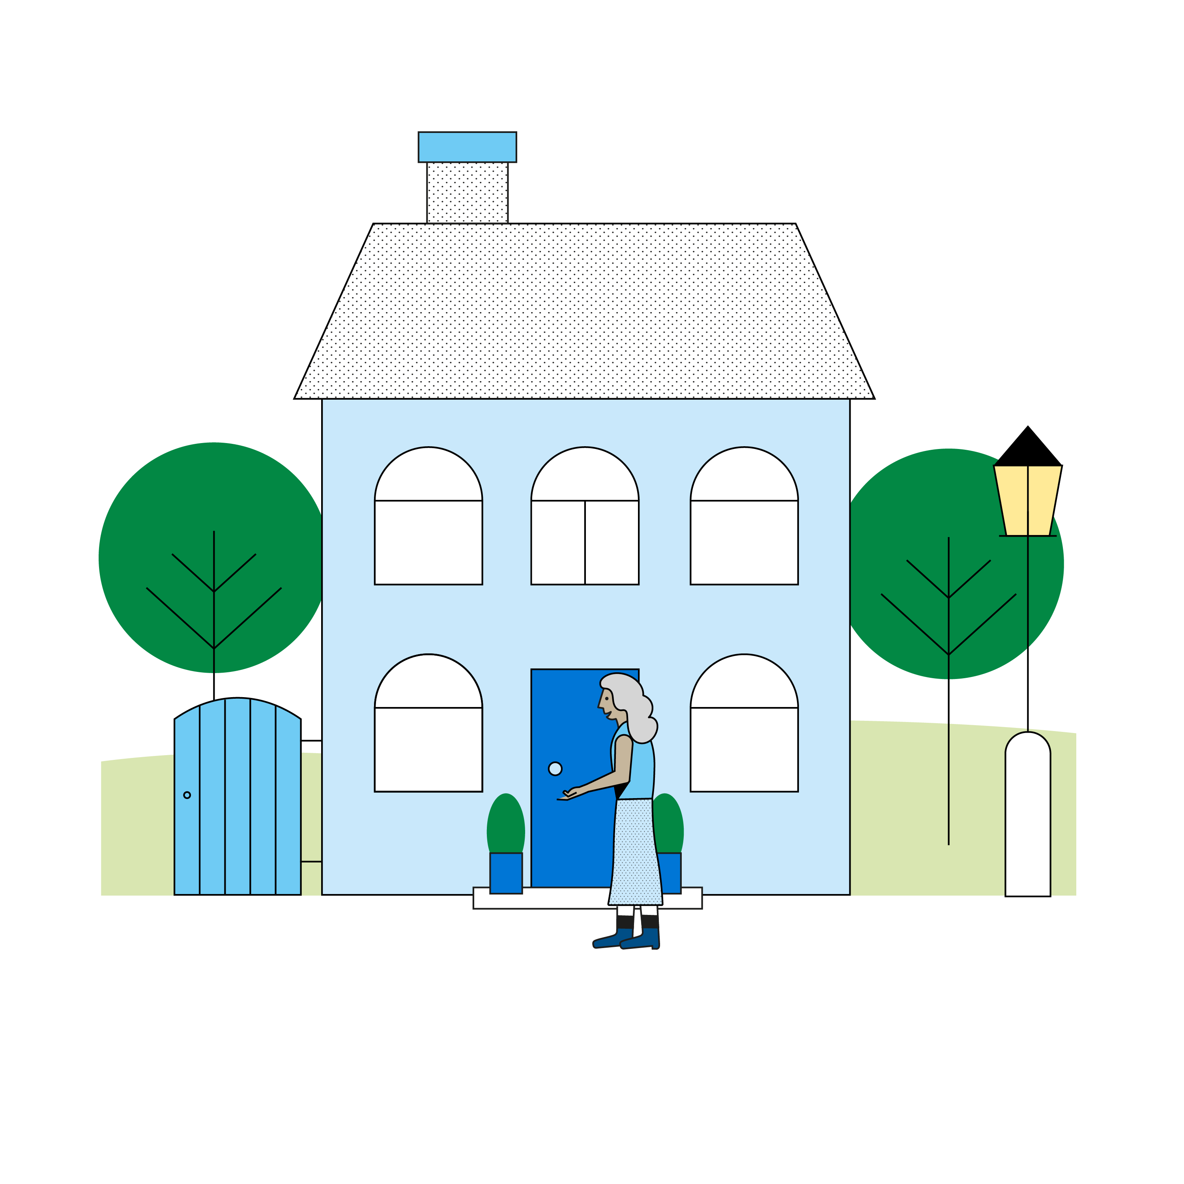
Caring for someone living with Dementia
Functioning at home – How to Help
Outside spaces and entry ways
Kitchens
Living Room
Bedrooms
Bathrooms
Décor and lighting
Notes:
Dementia can have a significant impact on a person’s daily life, including how well they function within their home.
Memory issues or problems recognising and interpreting the objects around them can cause the person frustration or create safety issues. The person’s difficulties can be made worse by other health conditions, which might affect their sight and mobility. To help the person with dementia maintain their independence and to support them to have a good quality of life, it’s important to make their home as easy to manage as possible and importantly safe. This could mean some changes.
If possible, try to involve the person with dementia in decisions about any changes you are making. If this is not possible, always make sure decisions are taken in the person’s best interests. Changes to a home do not have to be huge, nor expensive. Often with some simple adjustments, a home can become safer and more comfortable, helping the person with dementia to be independent and remain in their home for longer.
Keeping the outside of the person with dementia’s home the same over time can be really helpful to them. Maintaining the colour of the front door and looking after any trees or plants, so that they do not change substantially, can help the person recognise that they are coming home. A large door number can be helpful. There are some other simple things you can do to make going out or coming home straightforward. These include: • keeping the hallway uncluttered so it is easy to get in and out of the front door • having a clear, easy to read clock, with the day and date • keeping keys in the same place
Kitchens can be potentially hazardous as a person’s dementia progresses, but there are lots of steps you can take to make this room safer and easier to navigate. Making sure that everything the person may need is in easy reach can help, as can clear instructions and labels for commonly used kitchen equipment or items. Here are some ideas you could consider:
keeping cups, tea bags, spoons, or other commonly used things on the kitchen counter
sticking a photograph of the contents, or a simple sign, on the cupboard door.
clearly labelling hot and cold taps, either by writing the words on labels beside each tap, or, if possible, replacing with ‘hot’ and ‘cold’ marked taps
• using plain plates in one, light colour to make the food stand out and more appetising
using different coloured place mats from the plate, to make it easy to see and identifiable
• keeping on top of use-by dates by involving them in regular clear-outs
• looking into products that can help to maintain independence and safety, such as electric kettles that switch off automatically, or modified jar openers
Reduce the need to buy to use sharp or dangerous utensils, such as buying grated cheese, diced or minced meats or diced frozen vegetables
keeping toxic cleaning products in a locked cupboard
speaking to your gas supplier about gas valve limiters. These are usually free to install, and can be very helpful if you are worried about the gas being left on
The living room – lounges are meant to be a soft, calm and cosy space. Make sure chairs are comfortable and offer good support. Assistive furniture, which helps people stand up and sit down, can be very useful – although sometimes expensive
• it could be worth investing in remote controls with large, clearly labelled buttons that work with any television
• Voice assistants (such as Google, Alexa or Siri) can be useful, if a person starts to use them early in their dementia
• The living room can be a good place to put up photos of family, to reassure the person with dementia, and to act as a memory aid
• According to Dementia UK - The living room is one of the most common areas where falls happen. There are many things you can do, to reduce the risk of falls. These include: • making sure there is nothing unnecessary on the floor, especially wires and leads • removing rugs or making sure their edges are secured or stuck down • choosing furniture that is helpful – i.e. chairs that are the right height, and easy to get in and out of; and removing any chairs, stools or tables with thin legs, that can be tripped over • considering a personal alarm, that the person can press in case they do fall over (these can be kept somewhere in the room but are more useful if worn by the person). Your local authority can advise you on services offering this in your area. It is a good idea to take away any electric fires or heaters, that could be accidentally left on, or tripped over.
The Bedroom - It’s important for everyone to have a safe and relaxing place to sleep well at night, and a straightforward space to get ready in the morning. You can help by
• reducing clutter in the bedroom, so there is lots of room around the bed
• laying out clothes for the person, for the morning as some people with dementia can find choosing items from drawers or wardrobes difficult
• fitting a plastic mattress cover on the bed, if the person is suffering with incontinence problems
• ensure bedding is appropriate for the weather and keeps the person comfortable during the night. If the person is too hot or cold, they are more likely to wake up and become restless
• putting an easy to read clock somewhere prominent, set to the right time and date – if this is helpful to them
• having a touch-operated bedside light, or night lights on the landing, so the person can easily see if they get up during the night
Bathrooms – bathrooms can be scary, they are the room in the house in which we spend the least time and can easily seem unfamiliar in comparison to other rooms. We can help by:
• leaving the light on in the bathroom at night so it’s easier to find
• having a toilet lid and seat in a different colour to the toilet itself, so that it is easy for the person to identify
• removing toilet and bath mats, so that they person doesn’t slip on them. Some people with dementia have difficulties with their vision, where patterns or contrasts on the floor can look like a hole, or other obstacle
• choosing bath towels in a different colour to the walls so they are easy to identify and stand out
• installing grab rails at useful points around the bathroom, ideally in a different colour to the wall
A well-lit home can be helpful for a person with dementia, to allows them find their way around and reduce the risk of falls. To increase the amount of light in your home, you could try:
• creating more natural light by pushing back curtains and taking down net curtains or blinds
• having light-coloured curtains, if possible, to help reflect daylight
• having light and bright wall colours
installing lightbulbs with a high wattage
• placing the person’s favourite chair by a window so they get more natural daylight, and can look outside to see what is going on
• using portable low-level lights or a plug-in night light in hallways to help them see at night
At night time, you might like to use heavy curtains in the bedroom to help the person sleep.
What equipment can improve the home of a person with dementia? | Alzheimer's Society (alzheimers.org.uk)
Making the home safe and comfortable for a person with dementia (dementiauk.org)

Slide 13
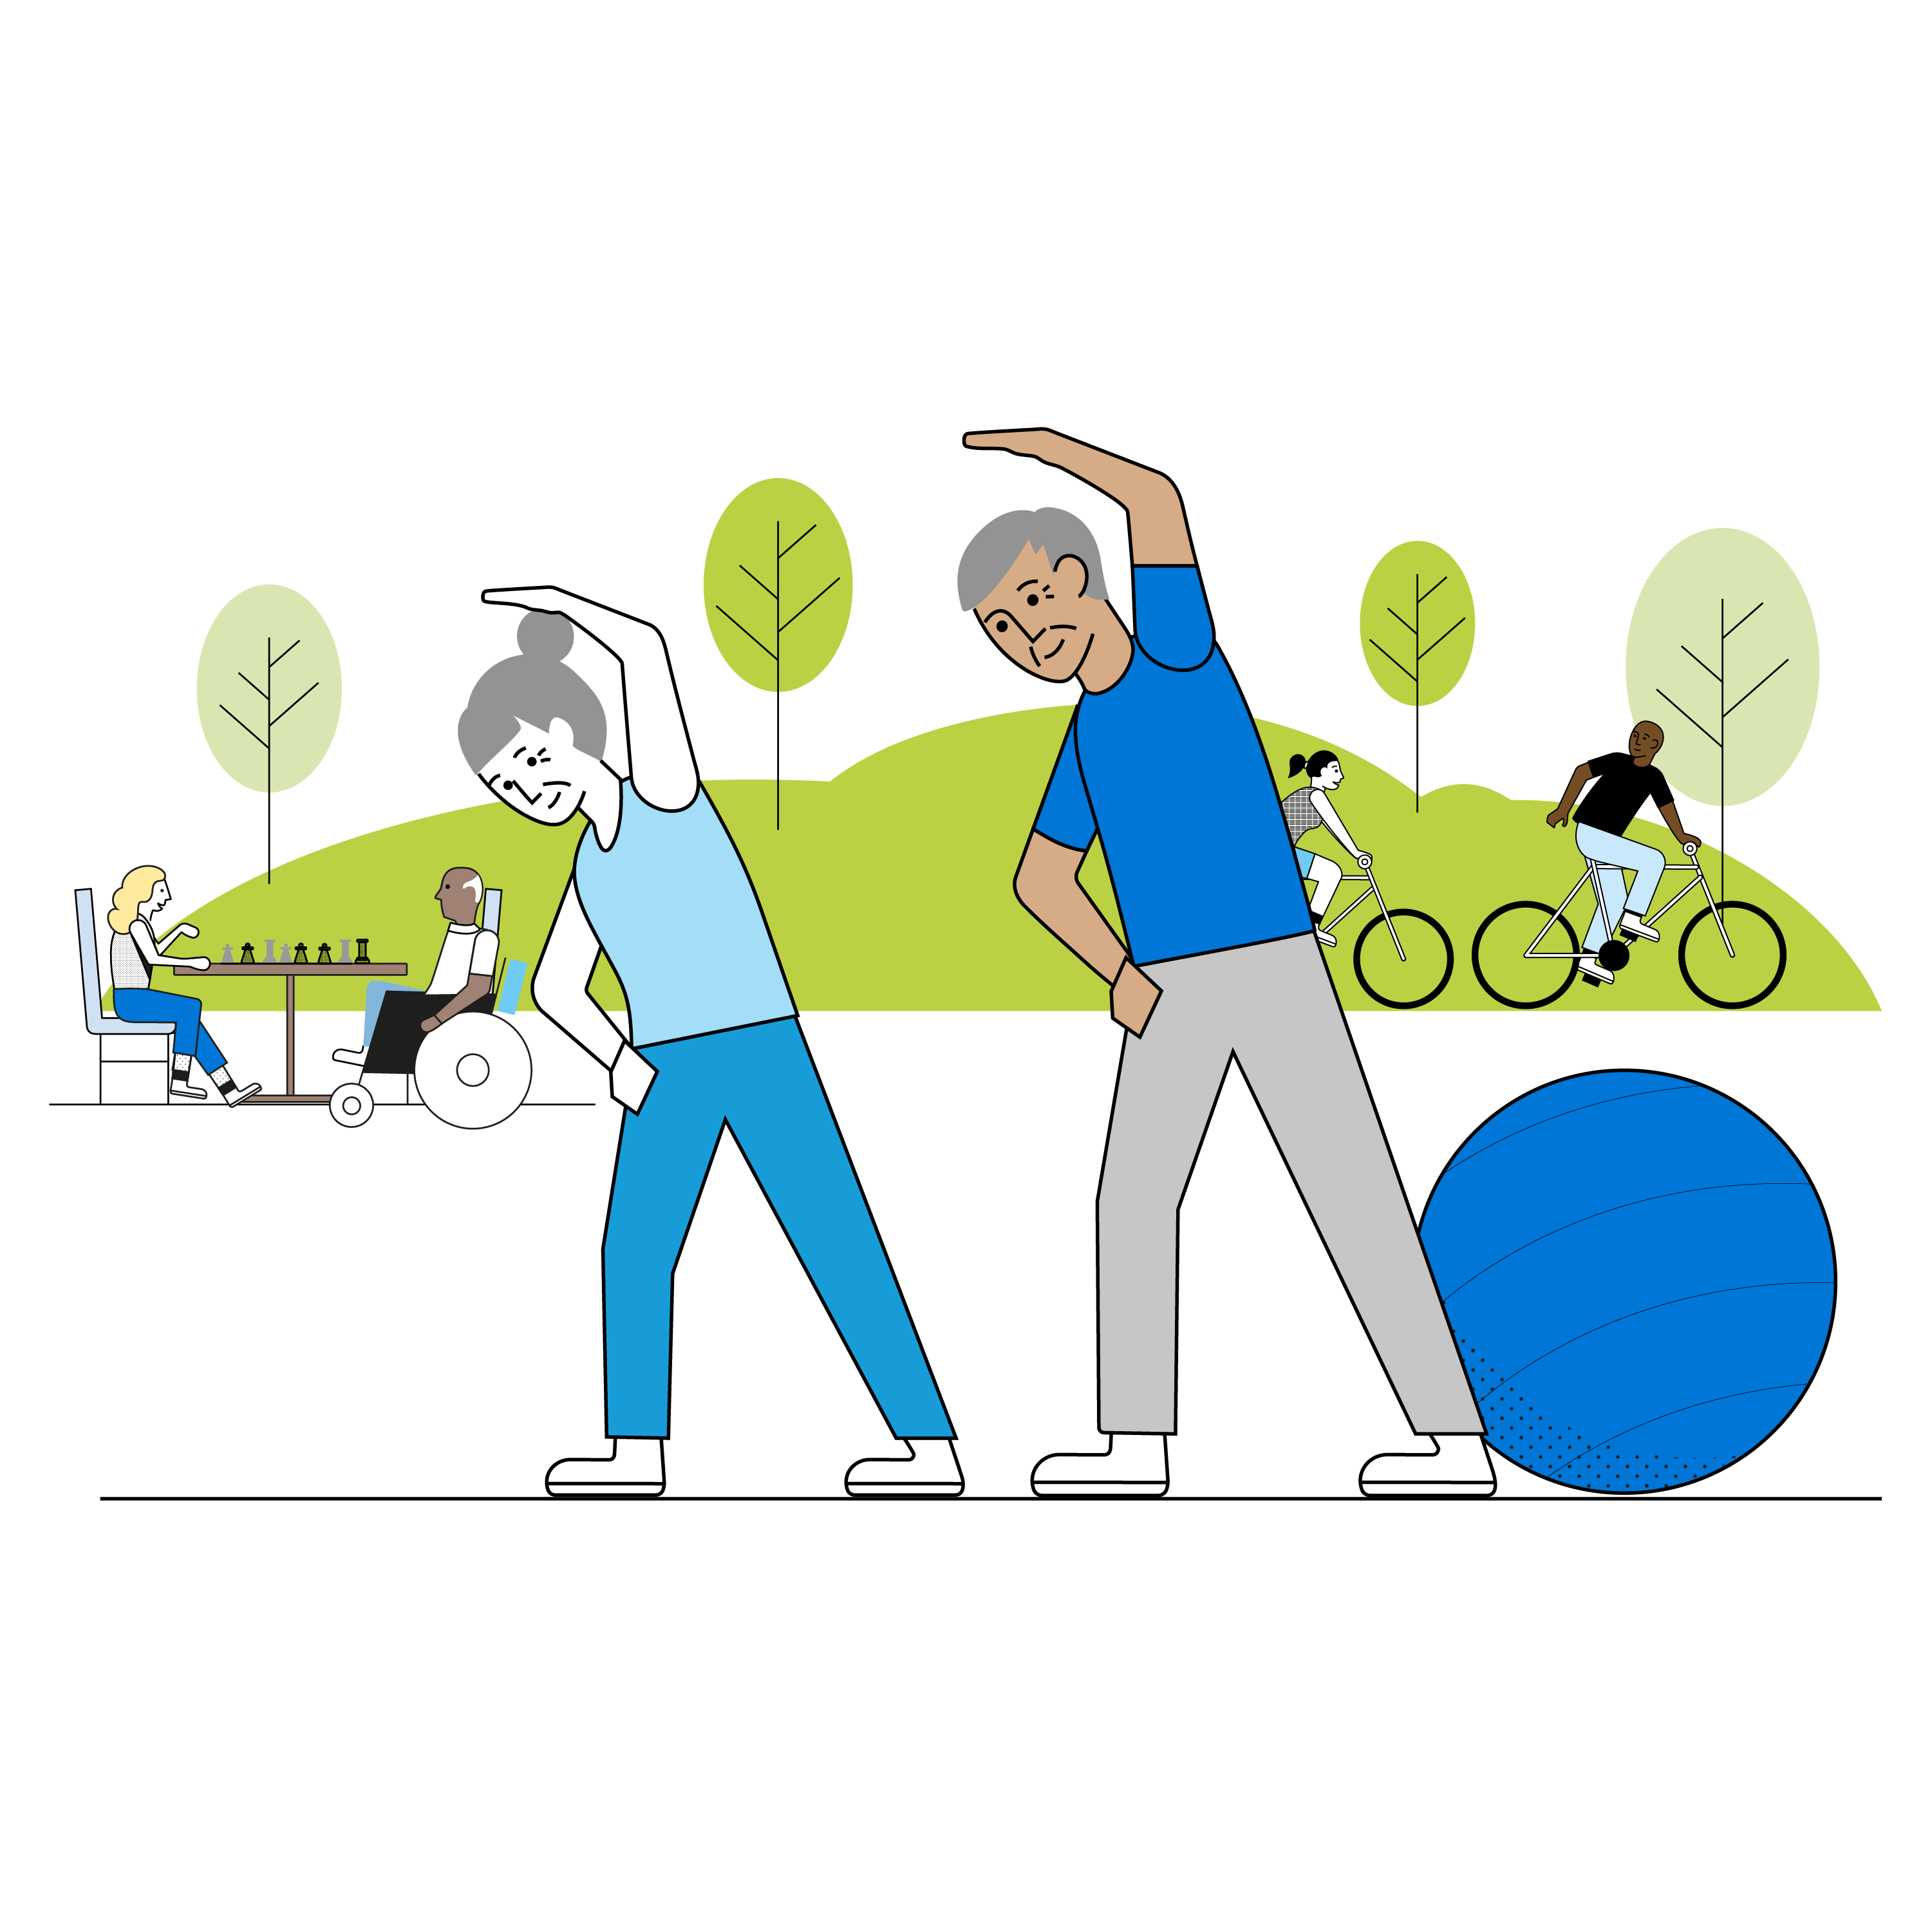
Caring for someone living with Dementia
How to stay fit and healthy whilst Caring
Look after your own emotional needs
Accept offers of help
Take a break
Helpful practices
Have a Carers Assessment
Notes:
The emotional demands of caring for someone can be high. As a carer, it is important to look after your own emotional needs. This is important so you can continue your caring role and maintain your own emotional resilience.
If the situation seems hopeless, some people find it helpful having hope for small things. For example, you may not be able to hope for a cure, but you can hope your loved one has a good day today.
Friends and family can offer significant support, but you may find it helpful to speak with a healthcare professional such as a counsellor. Often someone without an emotional connection to you or the person you care for will help you see things clearly.
A counsellor can help by:
suggesting strategies for managing relationships with the person who needs you and can giving you ideas for keeping communication channels open
advising you how to balance your caring role with your own needs.
Often it is reported by carers that they didn’t seek help for themselves as their loved one’s needs were more important. Remember that you are an important part of that persons care team and your wellbeing is vital to being able to provide support. Don’t be afraid to ask for help, if possible ask other family members for assistance if needed. If you are feeling distressed, frustrated, guilty, exhausted, or annoyed, it is important to know that these feelings are normal. If you find your role as a carer overwhelming, it may help to discuss your feelings with your GP or a counsellor to protect your own mental health.
Caring for someone can be relentless and exhausting so breaks are vital for your own wellbeing and quality of life. We all know that finding time to catch up with friends or family or to simply rest can make all the difference to how you feel. It's easy to neglect your needs though when you are focusing on those of another. After a break, many people feel recharged and rejuvenated and with a more positive outlook it is easier to cope with challenging circumstances. The person, or those, you care for could also benefit from enjoying new experiences, a change of scene and routine, and meeting other people. Carer support and respite services can help you to take a break from your caring role. You could have a volunteer stay with your loved one while you take a short break. If you need a longer break, the person you are caring for could go into respite care, so you can have some time away to rest and recuperate, or perhaps stay with another family member temporarily.
There are many useful organisations that can help you to organise a break. They may provide break services for carers or the person being looked after, or information to help you decide which alternative care services to use. Your local council or carers’ centre should have information about local charities and organisations.
Other ideas that may help you, and that you may not have thought of, include:
Take one day at a time. While thinking about the future is normal, try and focus on the challenges of caring just one day at a time.
Make a list of friends or relatives that can help. A list can clarify how many others you can call on. If no one is willing, ask the Local Authority if there is any extra help or volunteers.
Keep a diary of issues. This can help you keep track of issues and serve as a reminder when family meetings occur, these can then be discussed.
Ask friends or relatives to prepare meals. People are often willing to help. If this isn’t possible consider a home delivery service for meals.
Ask a friend to stay overnight. It may help you get a good night’s sleep and provide extra company.
Discuss flexible work options with your employer. Many employers offer flexible working arrangements. Talk to them about possible options.
Get someone to do your household chores. Ask a relative or consider a local private service or access help at your local council.
Give yourself regular rewards. Take a break, do something special that lifts your spirits and makes you feel good.
Finally, ask for a Carers Assessment
Your local council might be able to arrange practical help to allow you to care more effectively and reduce your stress. This could include things like arranging for someone to step in for a while to give you a break or providing some extra support for the person you care for, to give you more time for your other responsibilities.
To see if you can get practical help, you'll need the council to carry out a carer's assessment. All carers are entitled to this.
The carer's assessment looks at how caring affects your life and work, and how you can carry on doing the things that are important to you and your family. A carer's assessment isn't an exam - you won't be judged on whether the care you give is good enough.
The carer’s assessment is normally a face to face meeting with a trained person, either from the council or an organisation it works with. It could be at your home or the home of the person you care for. Alternatively, the assessment might be done over the phone.
In the assessment, you’ll discuss things like:
how much time you spend caring for the person
what sort of tasks you need to help them with, such as getting dressed, bathing, shopping, eating or dealing with money
whether carrying out your caring duties leaves you with enough time for your work, family and hobbies
whether any aspects of caring for the person are particularly hard to deal with, for example, do you worry about your own safety when helping them up the stairs
how caring is affecting your physical and mental health
The council or organisation it works with might send you a questionnaire to fill in before the assessment. If they don’t, it’s a good idea to spend some time before the assessment thinking about how caring affects your life and what might make things easier for you.
Carer's assessments - NHS (www.nhs.uk)
Advice for carers: Looking after yourself | Age UK

Slide 14
Thank You

